Slide 1
AI-Augmented Software Development Life Cycle SEZG534
Akshaya Ganesan
CSIS, WILP

Slide 2
Contact Session: 6 – Fundamentals of AI

Slide 3
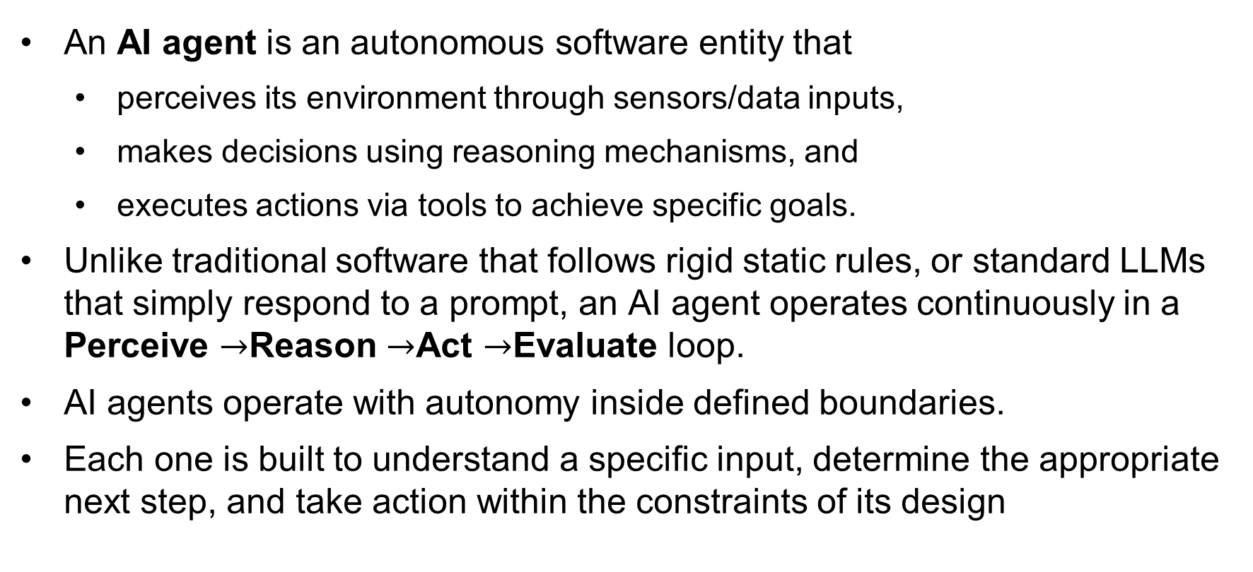
AI Agent
An AI agent is an autonomous software entity that
perceives its environment through sensors/data inputs,
makes decisions using reasoning mechanisms, and
executes actions via tools to achieve specific goals.
Unlike traditional software that follows rigid static rules, or standard LLMs that simply respond to a prompt, an AI agent operates continuously in a Perceive $→$Reason $→$Act $→$Evaluate loop.
AI agents operate with autonomy inside defined boundaries.
Each one is built to understand a specific input, determine the appropriate next step, and take action within the constraints of its design

Slide 4
Example
An agent built on top of GPT-4. Its environment is the computer with the terminal and the file system.
Its set of actions include navigate repo, search files,view files, and edit lines.
SWE-agent (Yang et al., 2024) is a coding agent whose environment is the computer and
whose actions include navigation, search, and editing. Adapted from an original image licensed under
CC BY 4.0.

Slide 5
Types of AI Agents
Agent Type | Core Mechanism | How It Decides | Real-World Example
Simple Reflex Agent | Condition-action rules (IF/THEN). Ignores history. | Reacts strictly to the immediate current perception. | Smart thermostat (If temp > 75°F, turn on AC).
Model-Based Reflex Agent | Internal state tracking + environment rules. | Considers current input plus an internal model of how the world evolves. | Automated braking system that accounts for wet road conditions.
Goal-Based Agent | Pathfinding & planning algorithms. | Chooses actions explicitly aimed at achieving a defined target state. | GPS Navigation (Find route to destination).
Utility-Based Agent | Multi-objective trade-off scoring. | Evaluates how well or efficiently a goal is reached using a utility function. | Ride-sharing dispatcher (Balance lowest wait time vs shortest driver distance).
Learning Agent | Self-improving feedback loop. | Operates with a learning element to adapt behavior based on environmental feedback. | Recommendation engines (Netflix/Spotify algorithms).
Generated by Gemini AI

Slide 6
Harness engineering
Agent = Model + Harness
The model contains the raw intelligence, and the harness makes that intelligence useful and actionable.
Harness engineering is how we build the environment around AI models to turn them into reliable, autonomous agents.
The model provides general intelligence (reading input/generating output), while the harness provides everything the model cannot do on its own -tools, state execution, context, permissions, and validation

Slide 7
Types
Harness layer | What it is | Who controls it | Example components
Coding harness | The runtime built into the coding agent | The agent or SDK maker | Tool use, system prompt, sub-agents, orchestration, code search, context management
User harness | The feedforward and feedback controls the team assembles on top | The team deploying the agent | Convention files, MCP servers, eval loops, custom skills, CLAUDE.md
Team · Org · SDLC harness | The shared platform layer that governs agents across teams | The platform team | Context lake, integrations, agent registry, permissions, orchestration, governance, human-in-the-loop, measurement

Slide 8
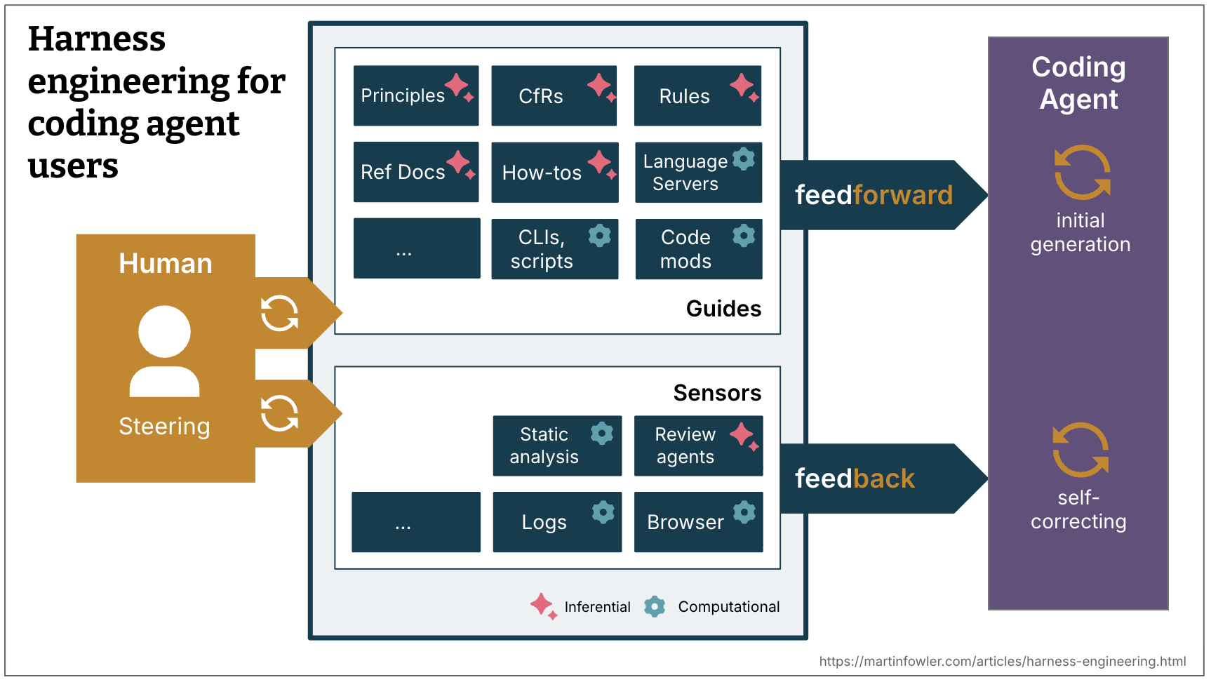
Harness engineering

Slide 9
Feedforward vs. Feedback (Guides & Sensors)
The agent harness acts like a cybernetic governor.
Guides (Feedforward): Steering the agent before it acts (e.g., system prompts, design specifications, convention files like CLAUDE.md or AGENTS.md).
Sensors (Feedback): Observing and enabling self-correction after the agent acts (e.g., custom linters, testing frameworks)

Slide 10
Execution Mechanics:
Computational vs. Inferential Controls
Categorizing controls by their computational engine and reliability
Computational: Fast, deterministic, and run on CPUs (e.g., type checkers, linters, pre-commit structural tests).
Inferential: Semantic, probabilistic, and run on GPUs/NPUs (e.g., "LLM as judge," autonomous code review).

Slide 11
Examples
 | Direction | Computational / Inferential | Example implementations
Coding conventions | feedforward | Inferential | AGENTS.md, Skills
Instructions how to bootstrap a new project | feedforward | Both | Skill with instructions and a bootstrap script
Code mods | feedforward | Computational | A tool with access to OpenRewrite recipes
Structural tests | feedback | Computational | A pre-commit (or coding agent) hook running ArchUnit tests that check for violations of module boundaries
Instructions how to review | feedback | Inferential | Skills

Slide 12
Where harness engineering fits in the AI SDLC
SDLC stage | What happens | Where the harness matters
Plan | Work gets scoped, context gets assembled | Context management decides what the agent sees before it starts
Build | The agent generates code or takes action | Tools, orchestration, and guardrails govern what it's allowed to do
Review | A human or agent checks the work | Sensors, such as tests and linters, catch problems before they ship
Deploy | The change goes to production | Approval gates decide what runs automatically and what waits for a human

Slide 13
Context Engineering
How does harness engineering relate to context engineering?
Context engineering provides us with the means to make guides and sensors available to the agent.
Engineering a user harness for a coding agent is a specific form of context engineering.
Context engineering is the practice of deliberately designing, structuring and optimizing the context provided to a large language model (LLM) to produce more accurate, relevant and reliable outputs.

Slide 14
Context Engineering
Agents need context to perform tasks.
Context engineering is the art and science of filling the context window with just the right information at each step of an agent’s trajectory.
“LLMs are like a new kind of operating system. The LLM is like the CPU and its context window is like the RAM, serving as the model’s working memory. Just like RAM, the LLM context window has limited capacity to handle various sources of context” -Andrej Karpathy

Slide 15
Why is context engineering important?
Context engineering involves structuring what information to include in the context that the LLM can access in real-time, and how to format that information so the LLM can use it correctly.
The context window can be thought of as the model’s short-term memory.
LLMs (and AI agents built on top of them) do not have long-term memory.
They generate responses solely based on the context window they have access to at inference time.
As a result, the quality and structure of the context window directly influence the model’s reasoning, tool use and outputs.
A well-managed context window will lead to better reasoning, tool calls and answers.
A poorly managed context window can lead to hallucinations, confusion or irrelevant outputs.

Slide 16
Context engineering
The core steps of the context engineering process are as follows:
Context selection
Context structuring
Prompt design and engineering
Context compression
Context sequencing
Tool and memory integration

Slide 17
Context engineering
Context retrieval
Context generation
Context processing
Context management

Slide 18
Context engineering➔Prompt and RAG
It encompasses two closely related and commonly discussed techniques: Prompt engineering and retrieval augmented generation (RAG):
Prompt engineering is the process of creating an LLM prompt that will lead to a better output.
This method is a subset of context engineering, but narrower in scope.
It doesn’t address the system prompts or any other information that the LLM has access to at inference time.
RAG focuses on ways to add information from documents or databases to the LLMs’ context window.

Slide 19
Prompt Engineering
Prompt engineering is critical because it directly influences the quality, relevance and accuracy of generative AI outputs.
A well-crafted prompt helps ensure that the AI comprehends the user's intent and produces meaningful responses, minimizing the need for extensive postprocessing.
“The problem is not with prompt engineering. It’s a real and useful skill to have. The problem iswhen prompt engineering is the only thing people know.”
prompt engineering ➔human-to-AI communication

Slide 20
Prompt
A prompt is an instruction given to a model to perform a task

Slide 21
Techniques in prompt engineering
Zero-shot prompting
Zero-shot prompting involves asking the model to perform a task without providing any prior examples or guidance. It relies entirely on the AI’s pretrained knowledge to interpret and respond to the prompt.
Few-shot prompting
Few-shot prompting includes a small number of examples within the prompt to demonstrate the task to the model. This approach helps the model better understand the context and expected output.
Chain of thought (CoT) prompting: CoT prompting encourages the model to reason through a problem step by step, breaking it into smaller components to arrive at a logical conclusion

Slide 22
System Prompt and User Prompt
The instructions provided by application developers are put into the system prompt, while the instructions provided by users are put into the user prompt.

Slide 23
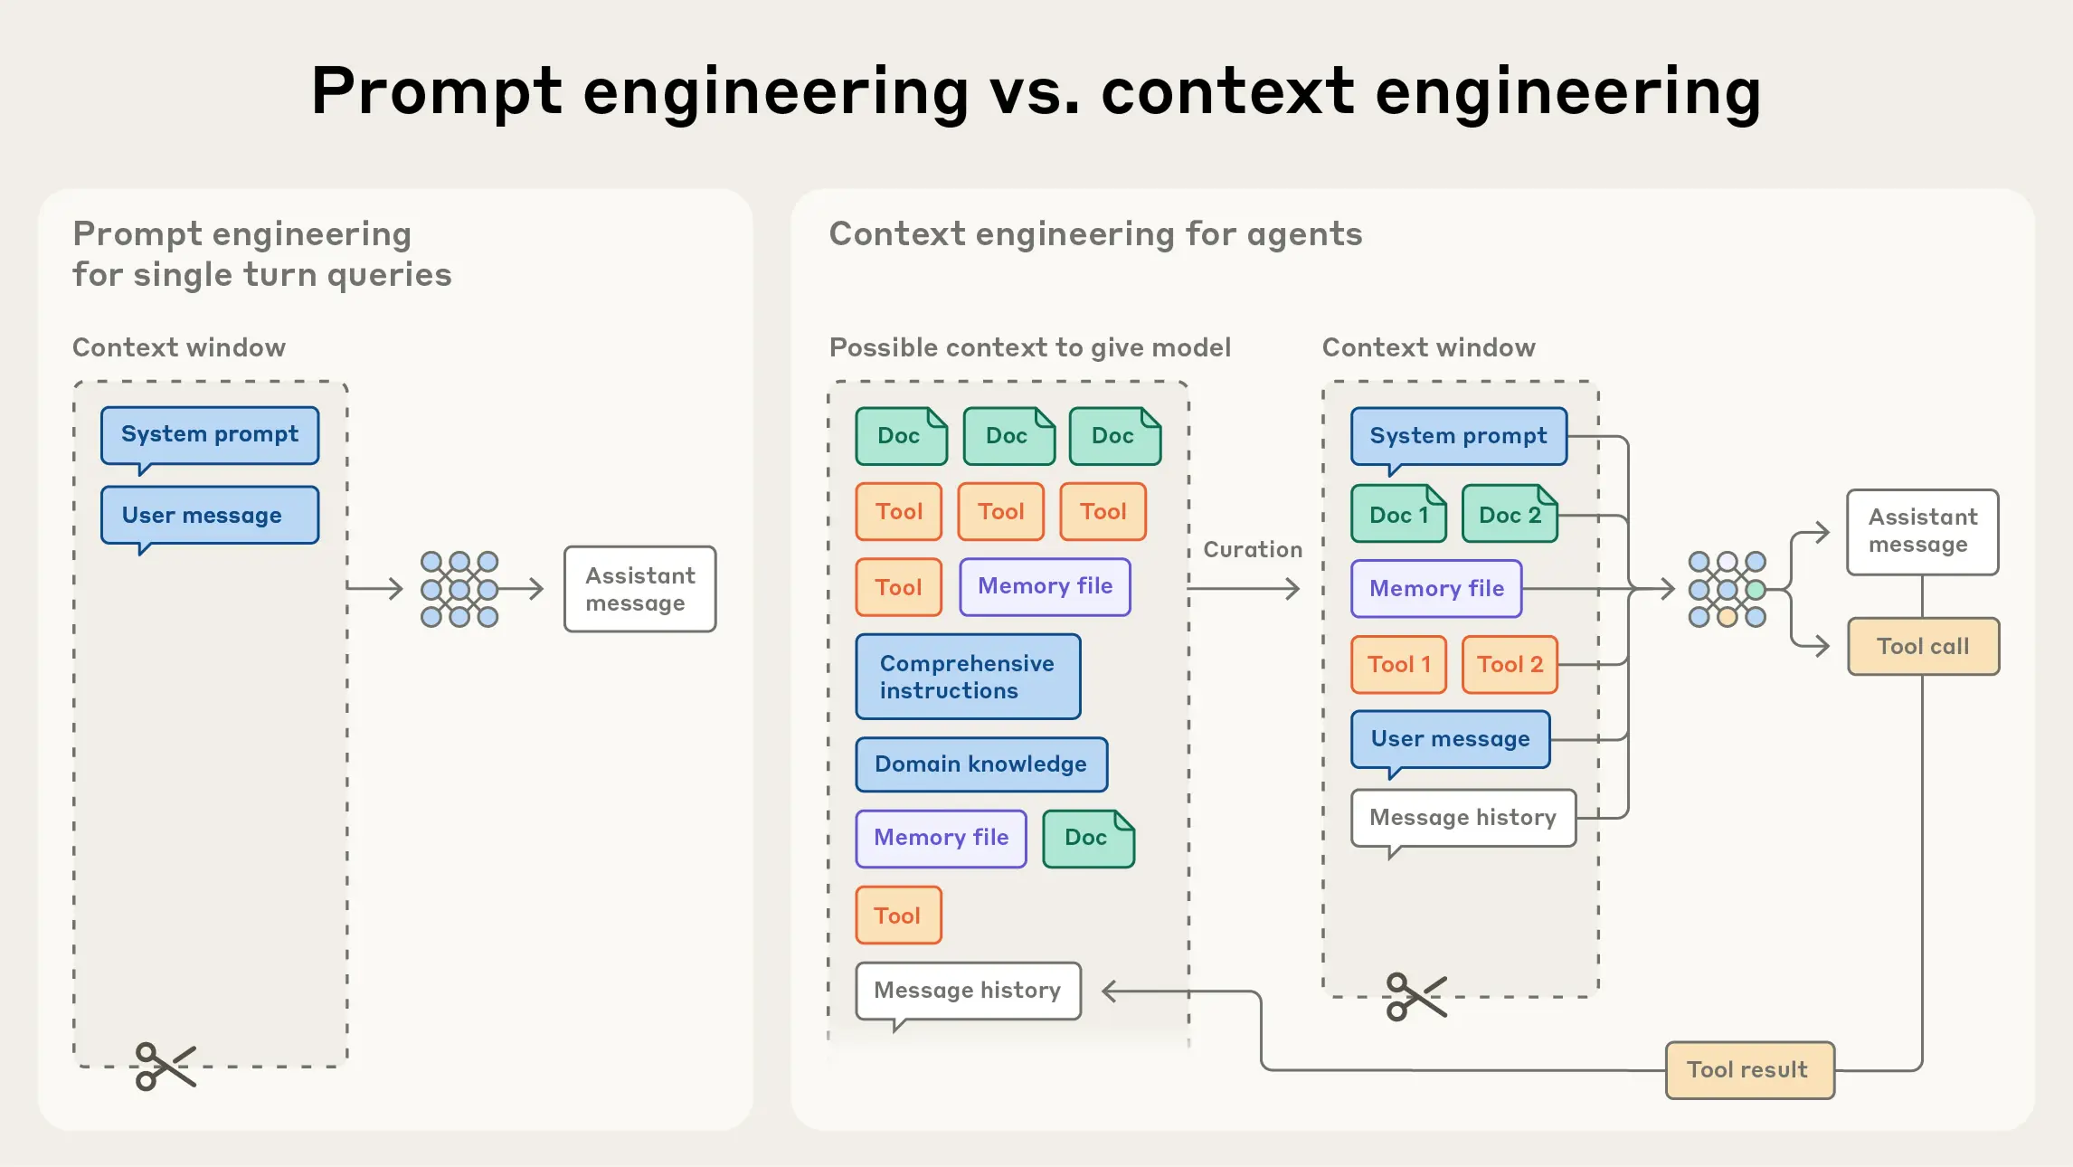
Context engineering vs. prompt engineering
In the early days of engineering with LLMs, prompting was the biggest component of AI engineering work

Slide 24
RAG
Retrieval-Augmented Generation (RAG) is the process of optimizing the output of a large language model, so it references an authoritative knowledge base outside of its training data sources before generating a response.
How RAG Works
Ingestion: Documents are cut into small pieces and saved as computer codes called vectors in a database.
Retrieval: When you ask a question, the system searches the database for the pieces that match your meaning.
Augmentation: The system adds those text pieces to your question to make a new, detailed prompt.
Generation: The Large Language Model (LLM) reads the custom prompt and writes a correct, fact-based reply.

Slide 25
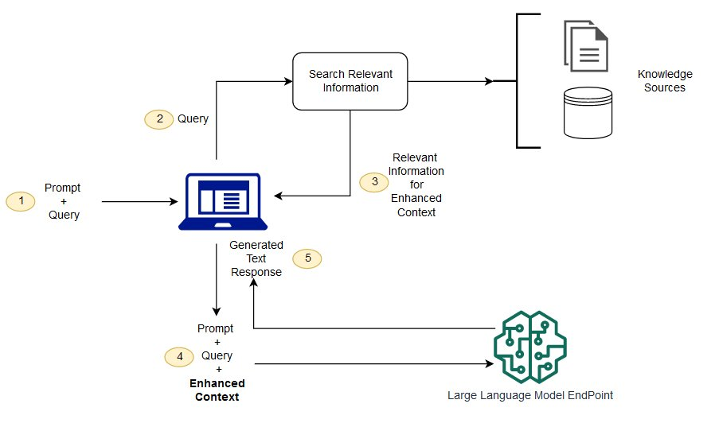
RAG

Slide 26
The three phases of AI engineering maturity
AI engineering maturity has moved through three distinct phases: prompt engineering (language), context engineering (information), and now harness engineering (environment).
Phase | Time period | Core Discipline | What It Entails | Software Engineering Focus | Primary Output
1 | 2022–2023 | Prompt Engineering | How we talk to the model | Syntax & phrasing: Refining natural language instructions to get better logic | Code snippets: Autocomplete and boilerplate generation
2 | 2024–2025 | Context Engineering | What the model knows | Relevance & memory: Curating the right data and rules for the model’s window | Feature logic: Context-aware file and system updates
3 | 2026 | Harness Engineering | How the model is allowed to act and self-correct | Autonomy & control: Building the feedback loops and safety rails for agents | Autonomous tasks: End-to-end task execution and verification

Slide 27
Two more New Phases
Loop Engineering:
Loop engineering is the practice of designing automated AI systems that let agents run repeated cycles of action, testing, and adjustment on their own until a goal is met.
Instead of a human prompting an AI model step by step, the developer builds a loop. The agent takes an action, checks the result against the target, and fixes errors until the job is done
Graph Engineering
Graph engineering is the practice of designing the graph an agentic system executes in: the nodes that do the work, the edges that route work between them, and the shared state that travels along those edges. A node can be an LLM call, a deterministic function, a router, a verifier, or a human approval step. An edge encodes which node runs next, either as a fixed transition or as a decision made at runtime. State is the data structure that every node reads from and writes to as work moves through the system.

Slide 28
Layers of AI - SDLC
The center of gravity in AI keeps drifting away from the model, and each shift picked up a name.
Prompt engineering. The words you send.
Context engineering. Everything the model sees, not just your instructions.
Harness engineering. The code around the model that runs tools, tracks state, and handles errors.
Loop engineering. The autonomous cycle that drives one agent toward a goal.
Graph engineering. The coordination layer across many loops, covering what runs when, in what order, and who checks whom.

Slide 29
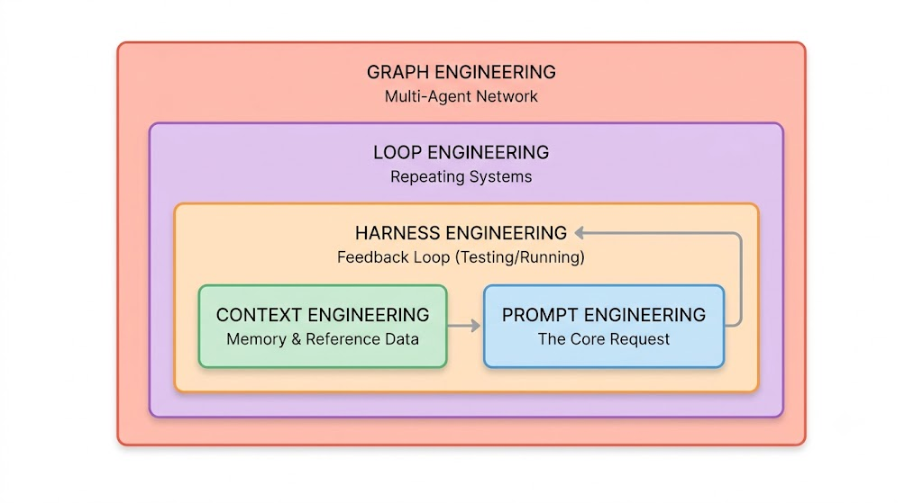
Layers of AI - SDLC
Generated by Gemini AI

Slide 30
Layers of AI - SDLC
The Three-Layer Operating Model (Spec → Harness → Loop)
The Spec Layer: Precise, human-authored intent and architectural constraints.
The Harness Layer: Mechanized validation (test suites, security gates).
The Loop Layer: The agent-driven continuous execution loop running until convergence
Three Gates of Agent Autonomy
Human-in-the-Loop: Active manual review of every agent PR/action (ideal for high-risk domains).
Human-on-the-Loop: Agent operates continuously while humans monitor dashboards and aggregate telemetry.
Autonomous: Fully independent execution within bounded constraints (ideal for routine, well-harnessed tasks)

Slide 31
References
https://martinfowler.com/articles/harnessengineering.html
https://outshift.cisco.com/blog/ai-ml/agentic-sdlc-new-evolution-in-software-engineering
https://www.faros.ai/blog/harness-engineering

Slide 32
Thank you

